Slide 1

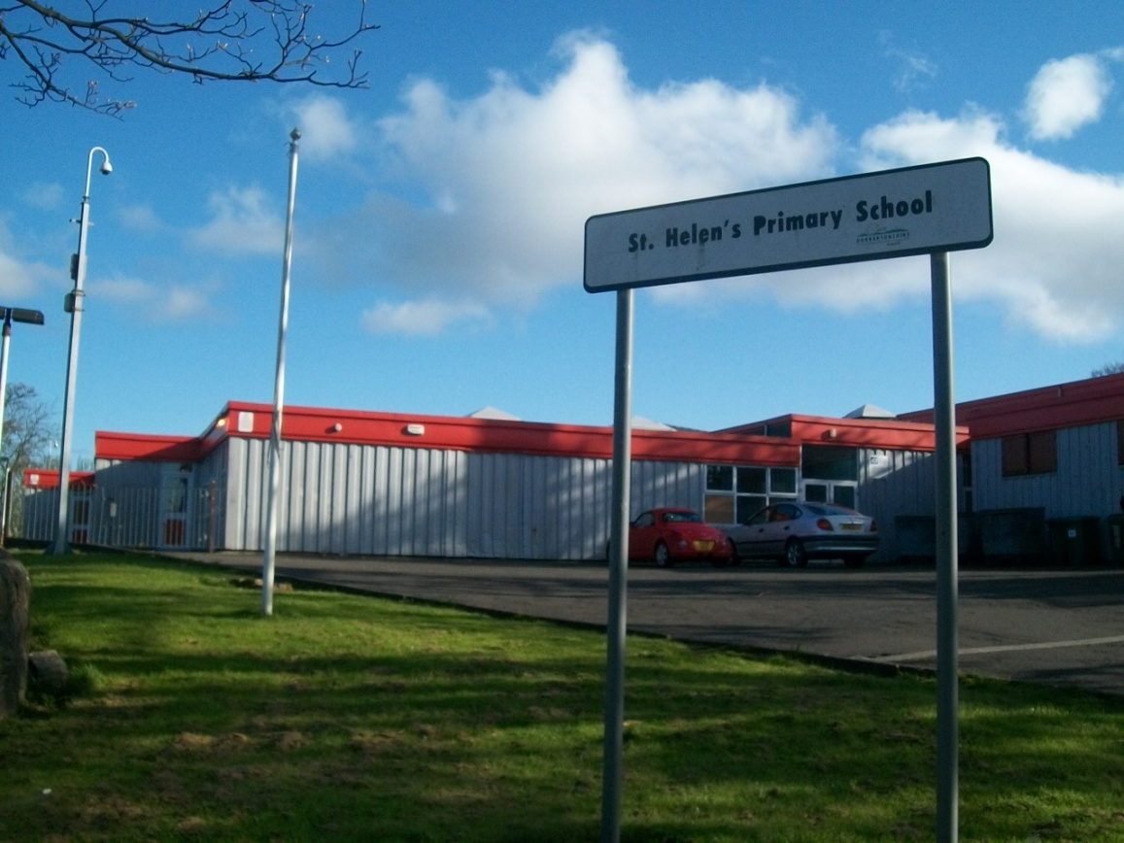








Welcome to
St. Helen’s P.S.

Slide 2
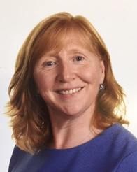
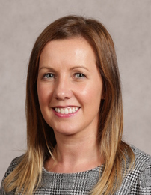
This is Mrs. O’Connor. She is the Head Teacher of St. Helen’s
This is Mrs. Murray. She is the Depute Head Teacher of St. Helen’s looking after P1-4.
This is Mrs. McWilliams. She is the Depute Head Teacher of St. Helen’s looking after P5-7.

Slide 3
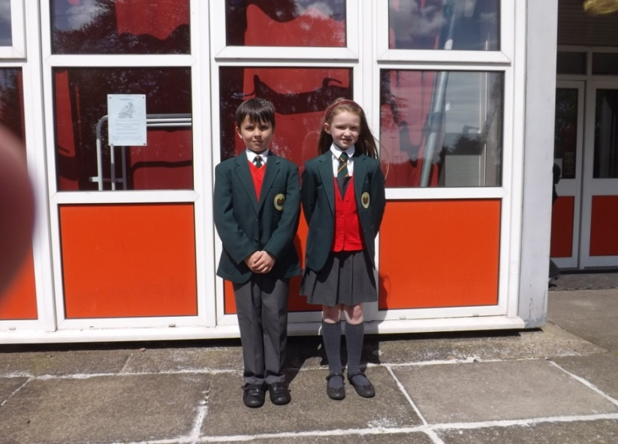
In St. Helen’s our uniform is: -
white school shirt/blouse
school tie
grey school trousers, skirt, pinafore
red school jumper or cardigan, v-neck, tank top
grey socks, tights
black school shoes/plain black training shoes
green school blazer
green school waterproof fleece

Slide 4
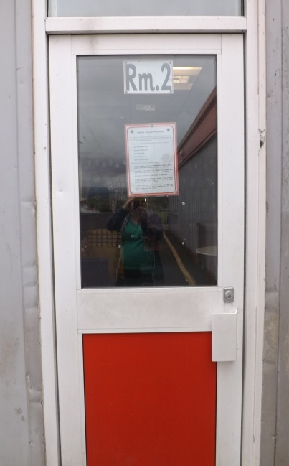
When you come to school you will be in Room 1 or 2.
This is where you will go each day and your Teacher will be there to let you into your class.

Slide 5
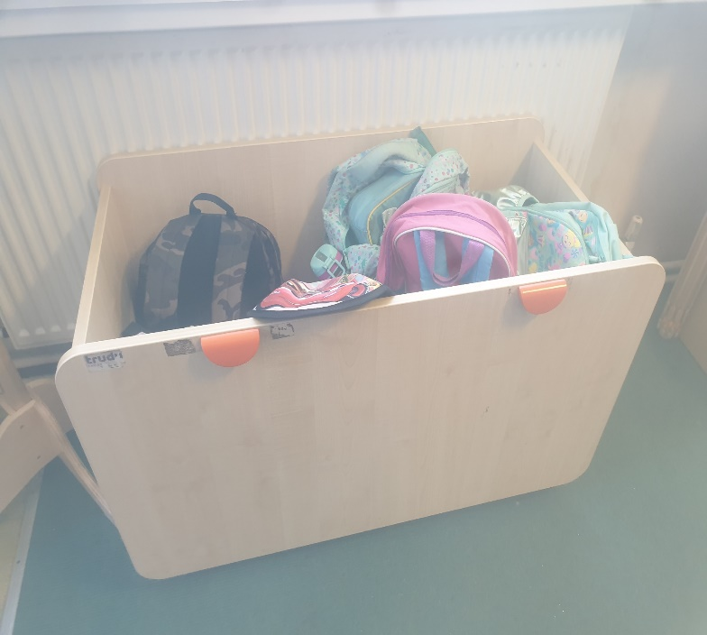
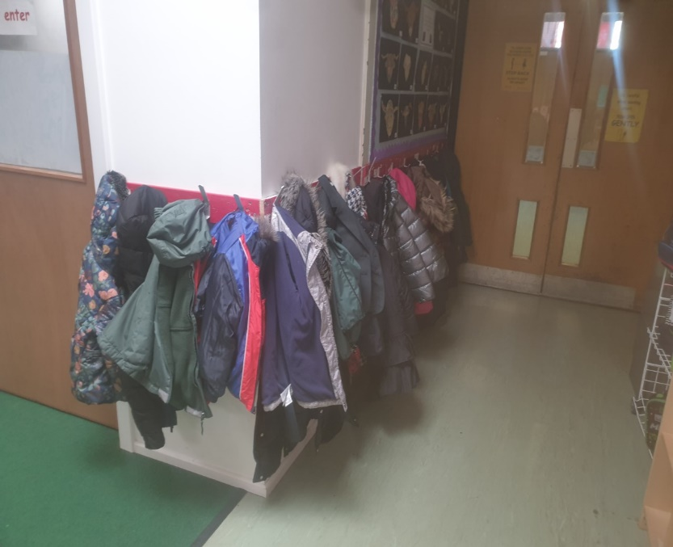
When you come into school you will put your bag in the bag box. Then outside the class you will hang up your jacket on your own peg in the cloakroom.

Slide 6
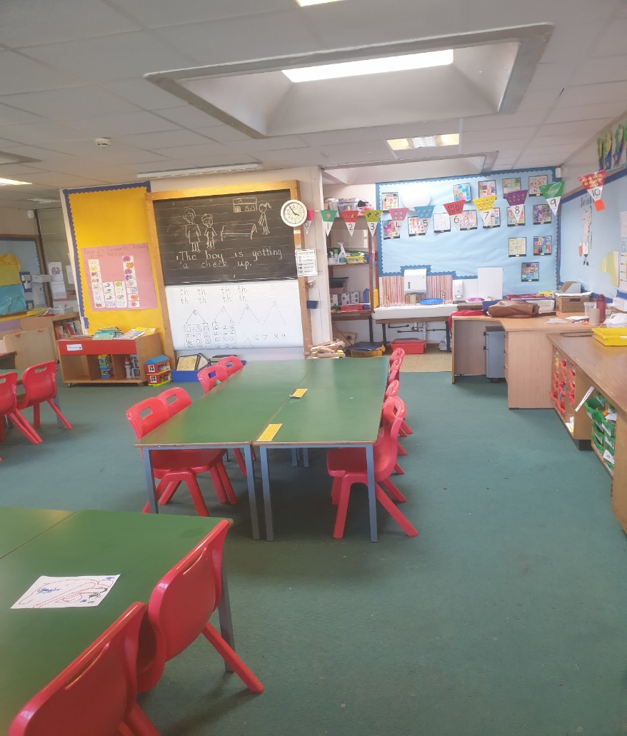
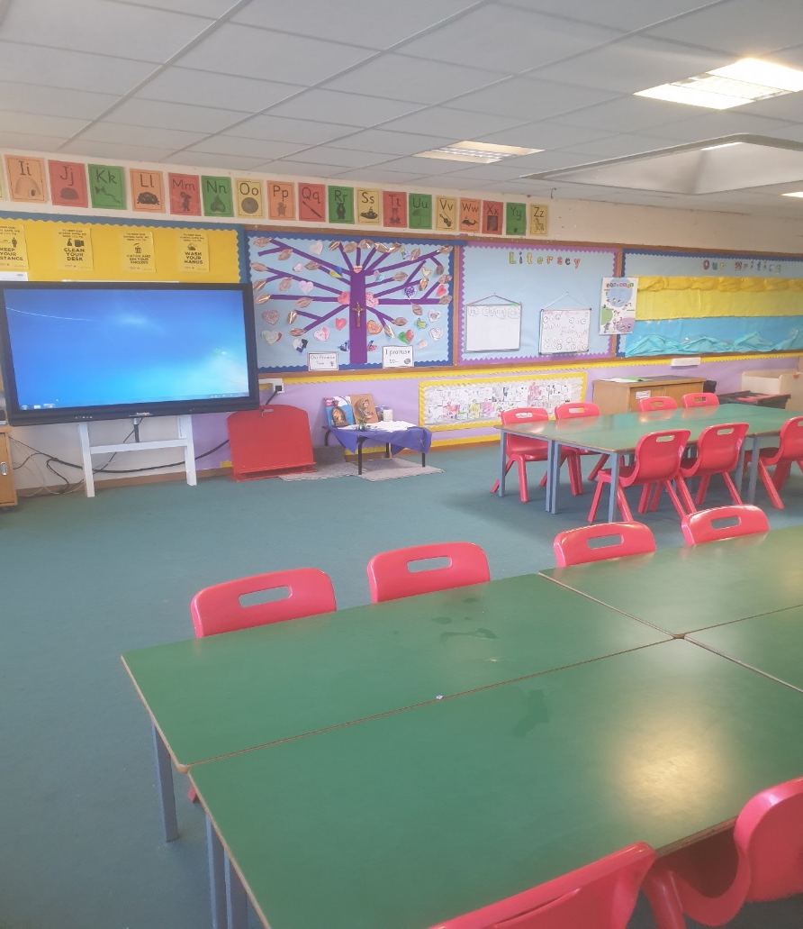
Your classroom will look like this…

Slide 7
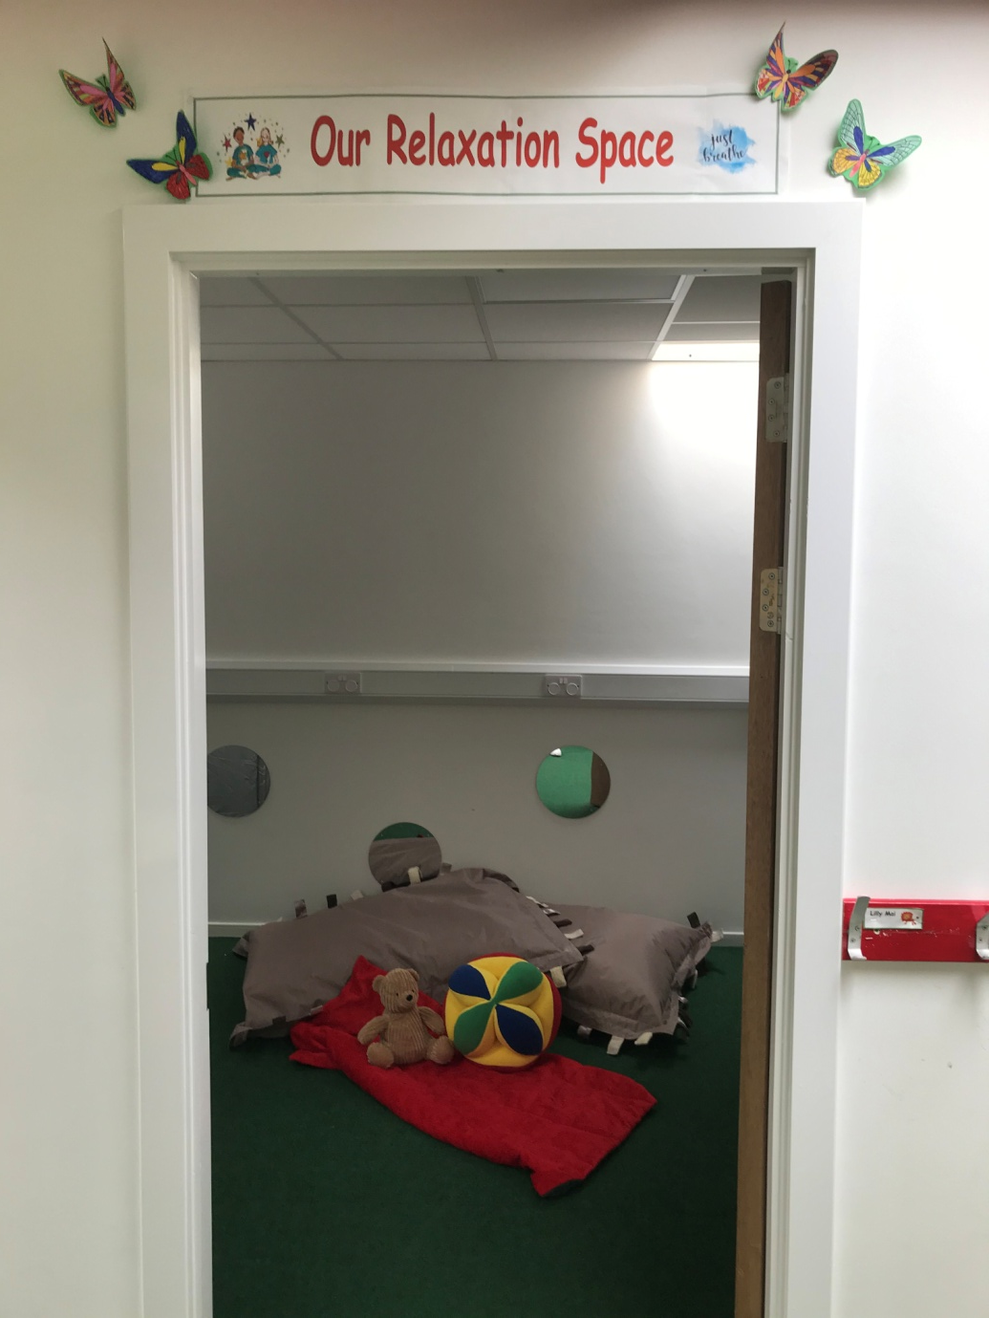
This is our quiet space where
you can come if you need to relax.

Slide 8
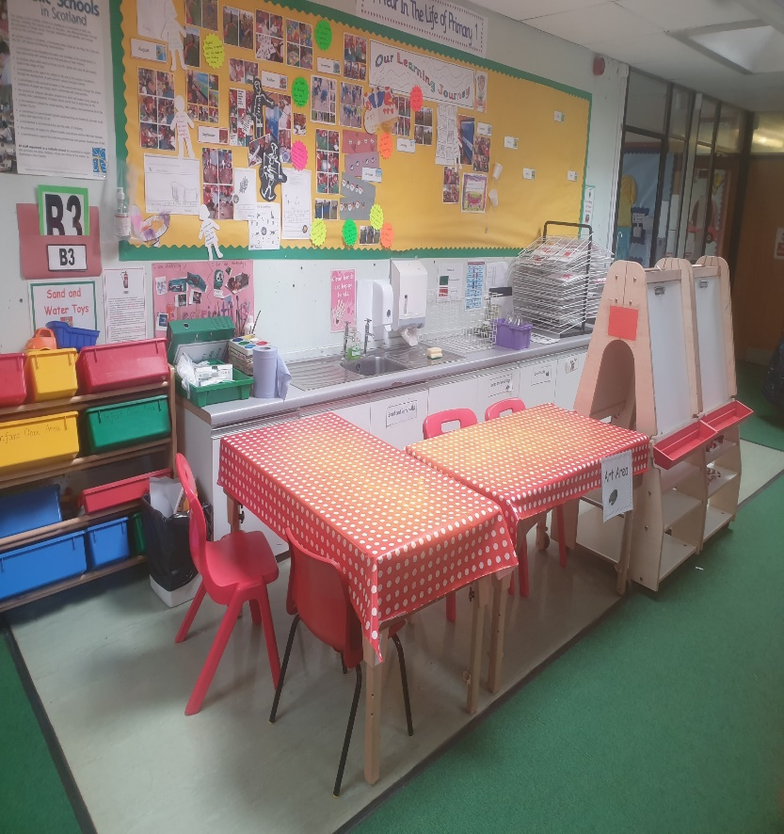
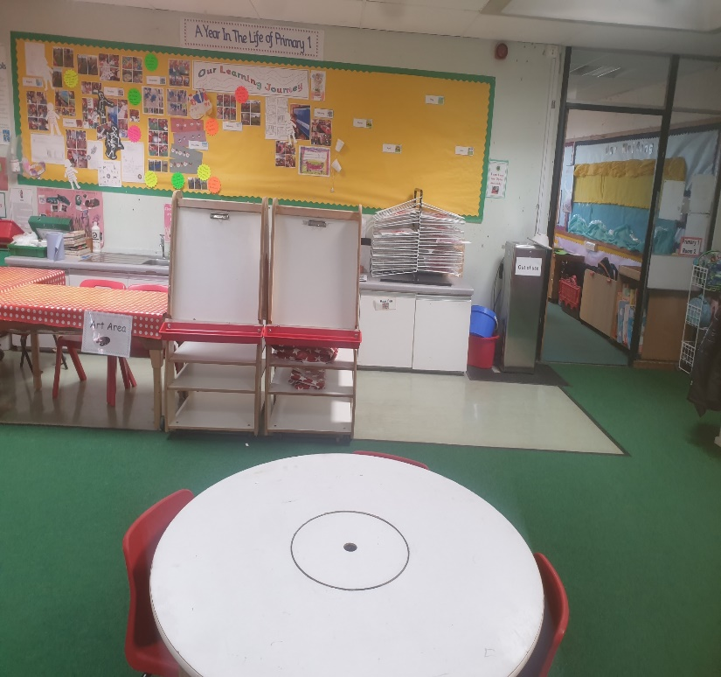
Our open area where
children play and learn.

Slide 9
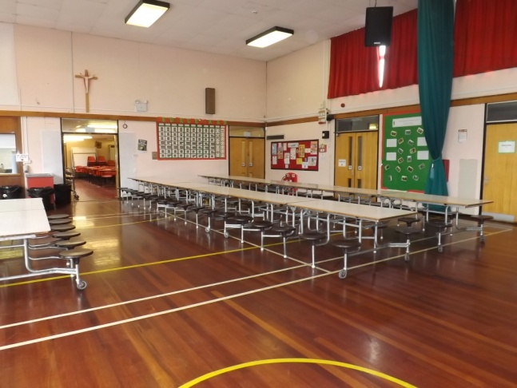
This is our hall. This is where you will eat your lunch

Slide 10
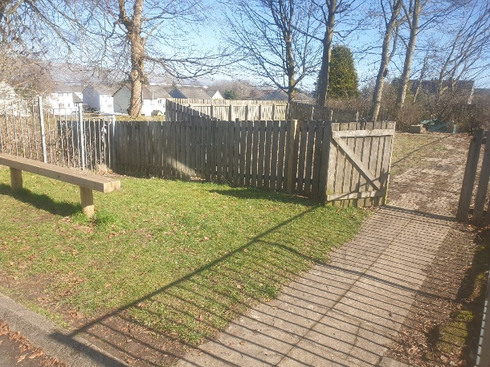
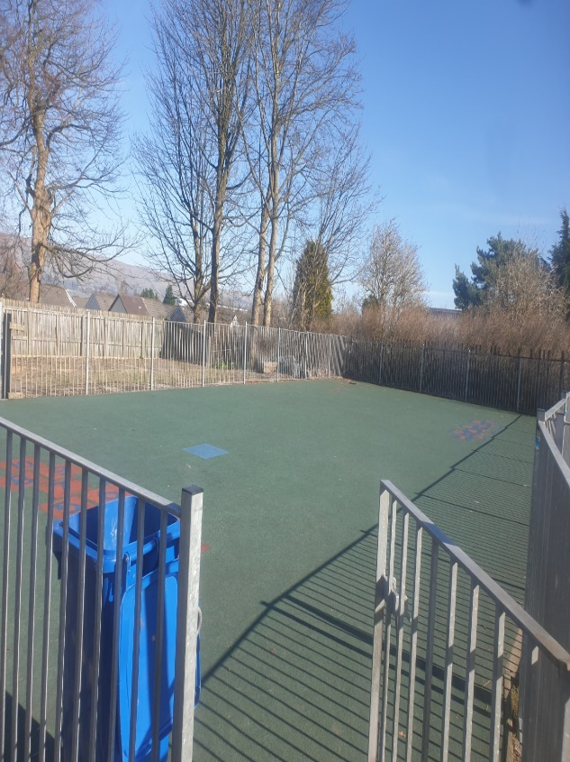
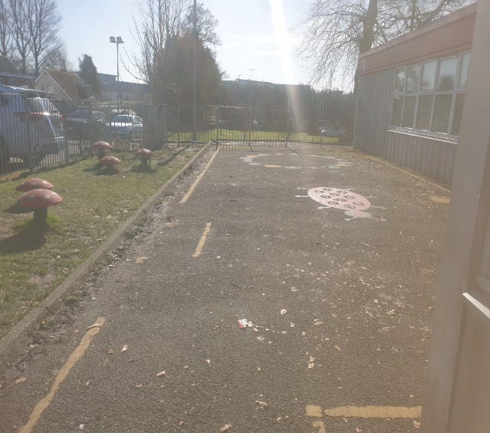
In the morning you will have a break so that you can go outside to eat your snack and play with your friends.
You will play here too after you eat you lunch in the dinner hall.
These are the
the areas where you can play.

Slide 11
We are all looking forward
to meeting you.

